Slide 1
Expanding Applications with Real-Time Acoustic Emission Acquisition

Slide 2
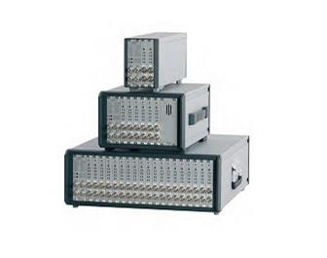
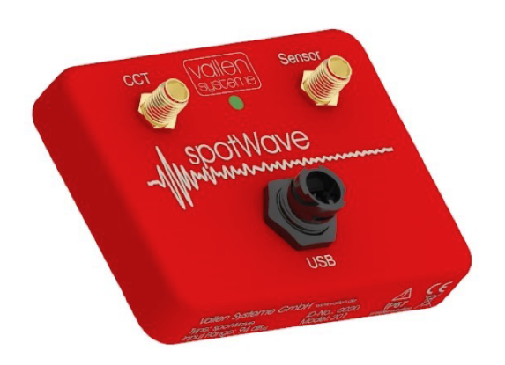
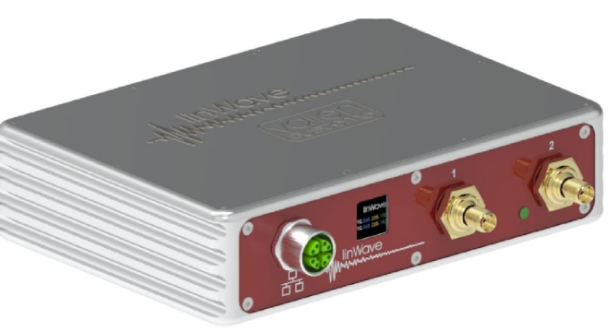
Real-Time Acquisition Methods for Acoustic Emission using Vallen Solutions
Vallen Systems offers multiple solutions that leverage real-time acoustic emission acquisition, with some differences in latency, acquisition configuration, access to data protocols, number of sensors and computing power. We will discuss three solutions: AMSY6, SpotWave, and LinWave.

Slide 3
AE DAQ | software | Tcp/ip | COM | Advanced configuration | On board computing power | Integrated amplifier | Parametric input | Nbr od sensors
AMSY-6 | * |  |  | * |  |  | * | 4-42
spotwave | * |  | * |  |  | * |  | 1
Linwave | * | * |  |  | * | * |  | 2
Software: Acquisition parameters can be adjusted and data can be retrieved using Vallen software. The data is saved in an SQL database and can be accessed in real time.
TCP/IP: Acquisition parameters can be adjusted, and data can be retrieved using a custom implementation leveraging the TCP/IP protocol: The Linwave interface is asynchronous and using asyncio for TCP/IP communication. This is especially beneficial for this kind of streaming applications, where most of the time the app is waiting for more data packets.
COM: Acquisition parameters can be adjusted, and data can be retrieved using a custom implementation leveraging the COM protocol: The spotWave operates as a USB Communications Device Class (CDC) device. By default, Windows assigns the usbser.sys driver, which exposes the device as a virtual COM port. This setup enables control of the device using serial commands over the COM interface
Advanced Configuration: Enables the extraction of additional features and the addition of capabilities such as pulsing and localization.
Onboard Computing: Capable of running algorithms and AI directly on the device, making it an edge computing solution.
Both spotWave and Linwave devices captures analog signals from connected AE sensors, converts them to digital form, and processes them based on the configured parameters. Adjustments made via the waveline library, such as setting input ranges or enabling filters, directly influence how the device processes incoming signals from the sensors, allowing for precise control over data acquisition and real-time monitoring

Slide 4
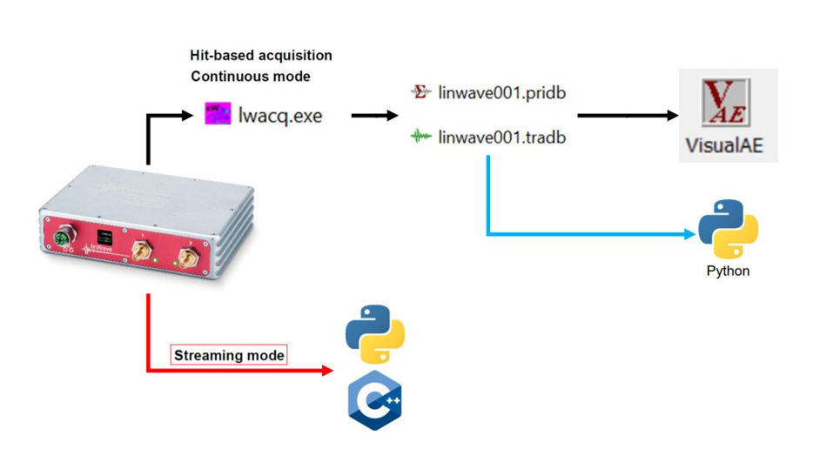
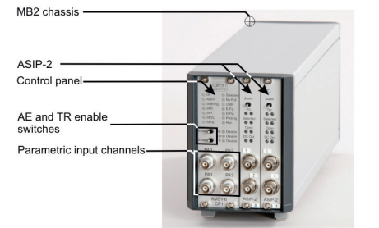
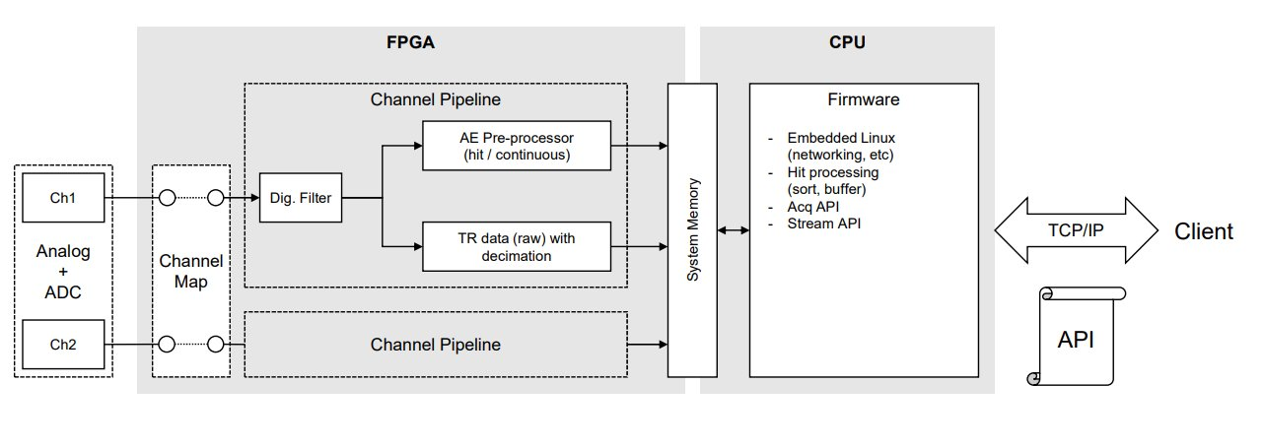

Slide 5
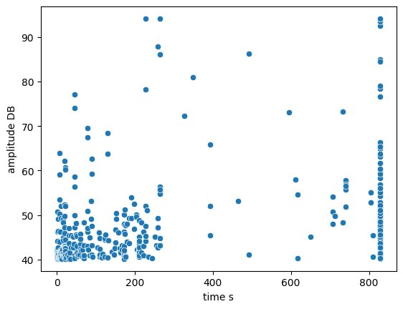
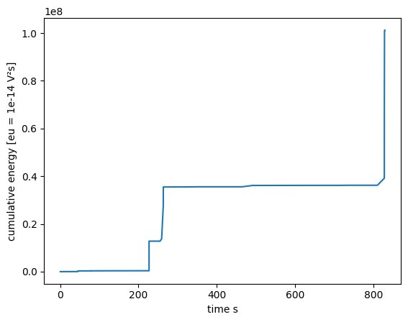
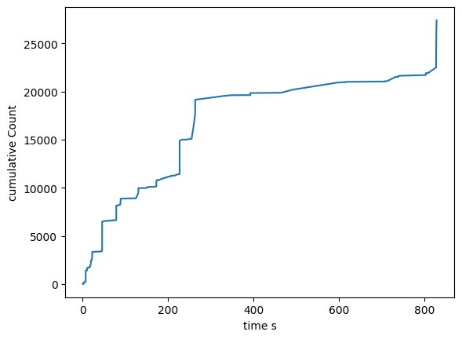
Unlocking New Possibilities with Real-Time Acoustic Emission Acquisition
1. Real time Feature Extraction
Those some examples of features that can be extracted in real-time:
Time-Domain Features
Time-domain features describe the signal's properties based on its amplitude variations over time
Rise Time: Time taken for the signal to reach its peak from the baseline.
Counts: Number of significant signal events detected.
Counts to Peak: Number of events leading up to peak amplitude.
Duration: Total duration of the detected event
Peak Amplitude: The highest absolute value of the signal’s amplitude, identifying sudden spikes.
Energy: Total power of the signal, computed as the sum of squared amplitudes.
Crest Factor: Ratio of peak amplitude to RMS, indicating the presence of sudden peaks.
Zero-Crossing Rate (ZCR): Measures how often the signal crosses zero, useful for detecting oscillatory behavior.
RMS-Crossing Rate (RMSCR): Counts how often the signal crosses its RMS value, useful for fluctuation analysis

Slide 6
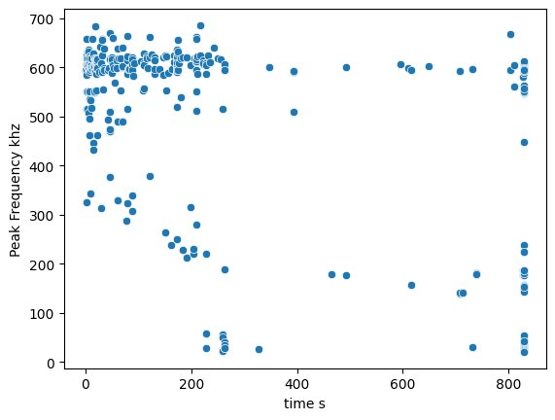
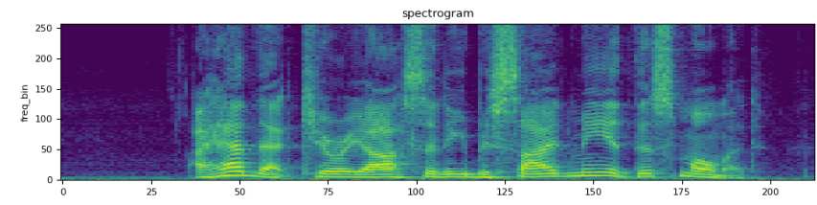
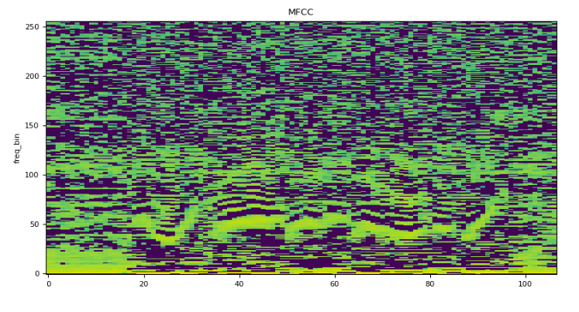
Frequency-domain features require Fourier Transform calculations: FFT with a Hanning window is needed
2. Frequency-Domain Features
Frequency-domain features describe the signal in terms of its frequency content after performing an FFT.
Peak Amplitude: The highest amplitude in the frequency spectrum.
Peak Frequency: The frequency at which the highest amplitude occurs.
Strong Peak: The most dominant frequency component in the spectrum.
Spectral Centroid: The "center of mass" of the frequency spectrum, representing its balance.
Spectral Flatness: Determines how flat or peaked a spectrum is. A high value indicates noise-like signals, while a low value suggests a tonal signal.
Spectral Rolloff (95%, 90%, 75%, 50%): The frequency below which a certain percentage of total spectral energy is contained. Helps distinguish between tonal and percussive sounds.
High-Frequency Content (Masri, Brossier, Jensen methods): Measures how much energy is concentrated in high-frequency ranges, useful for analyzing sharp transients.
Partial Power (10-500 kHz, 128 bands, Linear Scale): requires multiple FFT bins to be summed Divides the frequency spectrum into 128 linear bands and measures power in specific ranges.
Mel-Frequency Cepstral Coefficients (MFCC, 64 bands): FFT + Mel Filter Bank + DCT (Discrete Cosine Transform) Commonly used in speech and sound analysis. Extracts important frequency characteristics based on the Mel scale, which mimics human hearing.

Slide 7
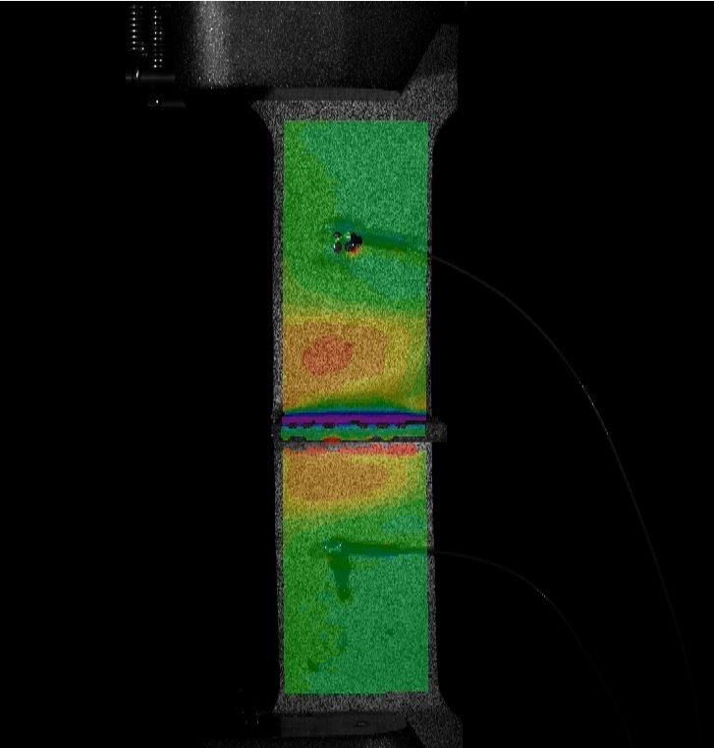
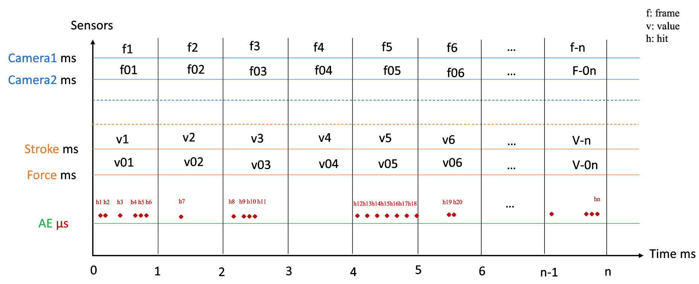
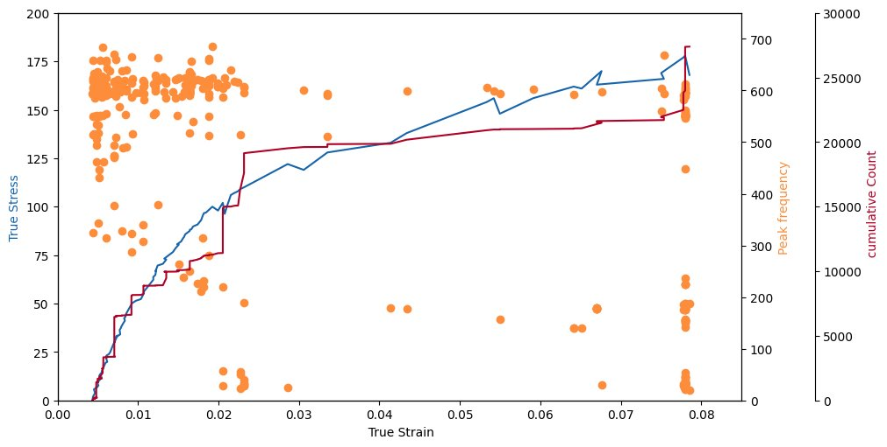
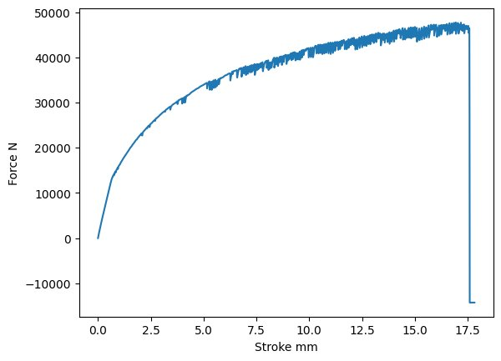
2. Real time data synchronization
By extracting time-domain and frequency-domain features in real-time and synchronizing them with data from other sensors, we can create a more holistic analysis of the system being monitored. Synchronization is achieved using timestamps or common reference signals, ensuring that all sensor data aligns accurately in time. This multi-sensor fusion approach enhances feature correlation, allowing us to detect complex patterns and interactions that single-sensor analysis might miss. Once synchronized, the data can be pre-processed before being fed into machine learning (ML) and deep learning (DL) models. These models can then be trained to classify patterns, detect anomalies, or make real-time predictions.

Slide 8
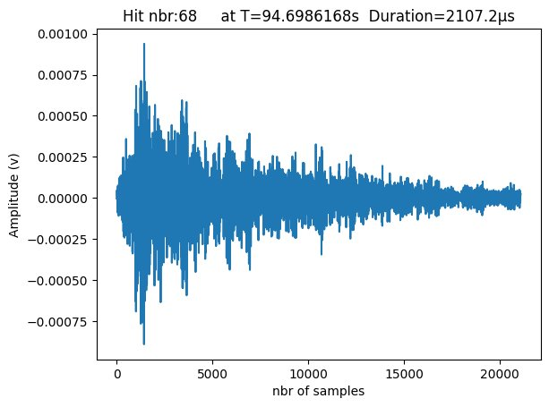
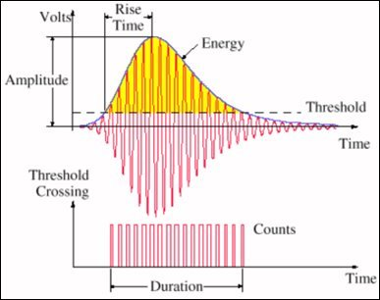
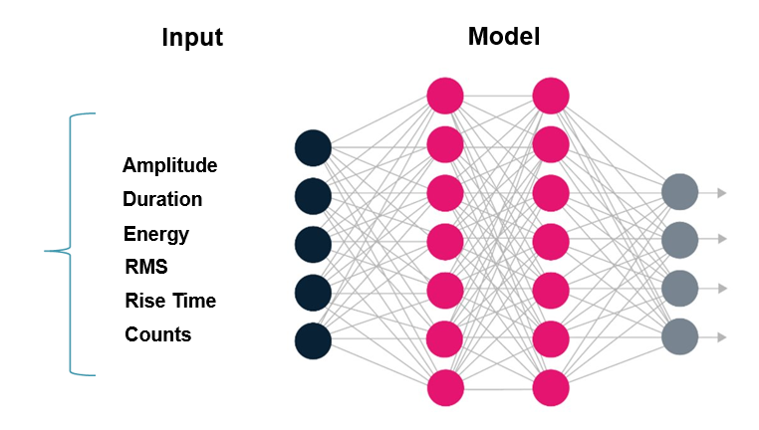
3. Real time AI
1. Feature-Based Machine Learning and MLPs
Extracting relevant features from acoustic emission data enables traditional machine learning (ML) and Multi-Layer Perceptron (MLP) models to process and classify events efficiently. By converting raw signals into numerical representations such as amplitude, frequency content, energy, and statistical properties, these models can learn from structured data with reduced computational complexity. Feature-based approaches excel in scenarios where domain knowledge can guide feature selection, allowing for interpretable decision-making. Additionally, probabilistic models and statistical methods, such as Gaussian Mixture Models (GMMs) and Hidden Markov Models (HMMs), can enhance pattern recognition by modeling uncertainties in the data. This method is computationally efficient, enabling real-time inference with minimal hardware requirements. However, it may struggle with capturing complex temporal dependencies or spatial representations of signal variations
Feature extraction

Slide 9

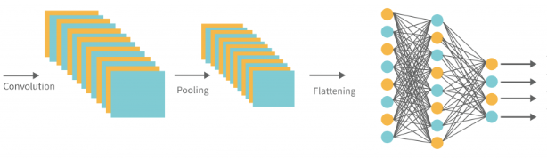
2. Image-Based Deep Learning with CNNs
Transforming acoustic emission signals into images (such as spectrograms or wavelet transforms) unlocks the power of Convolutional Neural Networks (CNNs). This approach leverages the spatial hierarchies of CNNs to extract high-level patterns from frequency-time representations, making it highly effective for classification, anomaly detection, and forecasting tasks. By encoding the signal into a 2D representation, CNNs can automatically learn meaningful features without the need for manual feature engineering, improving adaptability and generalization. However, this comes at the cost of increased computational complexity and memory requirements, making real-time inference more demanding. The trade-off lies in balancing model accuracy and computational efficiency, as CNNs often require specialized hardware (such as GPUs) for optimal performance.
CWT: Continuous Wavelet Transform

Slide 10
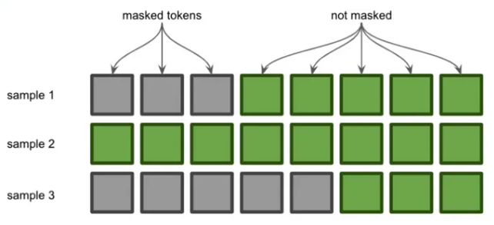
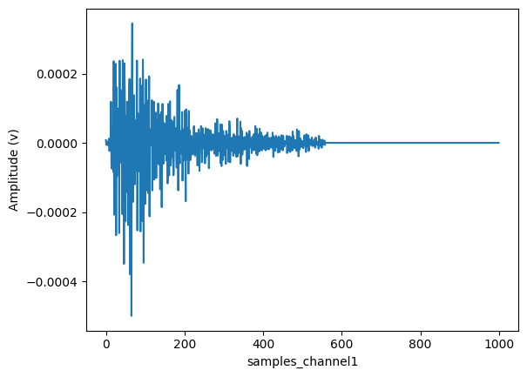
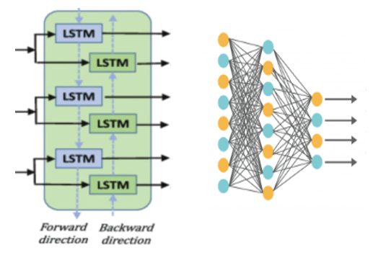
Padding and Masking
2. Raw Signal Processing with RNNs and Transformers
Maintaining the full waveform as input, combined with padding and masking techniques, allows for sequential modeling using Recurrent Neural Networks (RNNs), Long Short-Term Memory (LSTM) networks, and Transformers. These architectures capture long-term dependencies in the signal, making them particularly effective for time-series forecasting and anomaly detection. Unlike feature-based ML, RNNs do not require handcrafted features, and unlike CNNs, they do not need signal transformation into images. However, the trade-off is significant computational overhead, as recurrent models must process sequences step by step, leading to longer inference times. Transformer-based models, such as attention mechanisms, can improve efficiency by parallelizing computations, but they require substantial computing power. While this method can achieve high accuracy by preserving the full temporal resolution, its real-time deployment is more challenging due to inference speed constraint

Slide 11
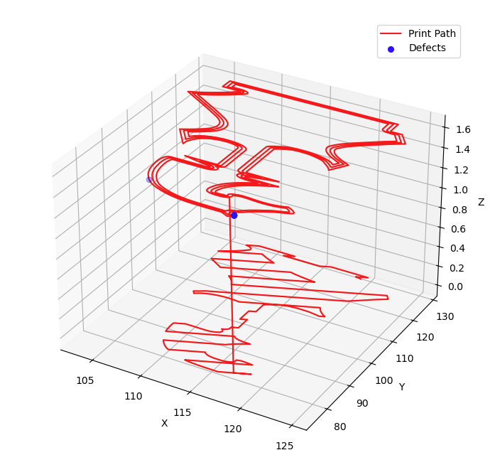
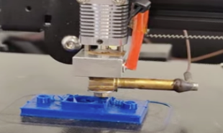
Real-Time AI-Powered Applications for Acoustic Emission Analysis
1. Classification and anomaly detection
In the additive manufacturing field, we applied feature extraction and deep learning to classify vibrations in the nozzle and detect abnormal activities in the material flow. These anomalies often lead to defects in the print job, such as inconsistent layers or material deposition issues.

Slide 12
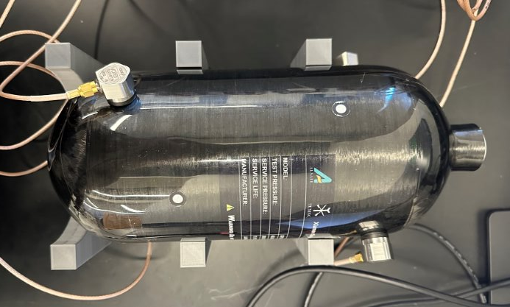
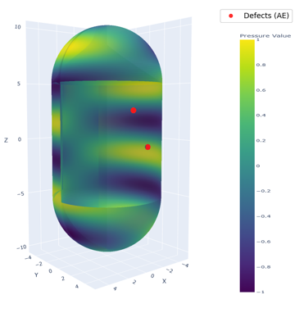
This study, still in progress, aims to identify microcracks and material deformation under varying pressures. We applied Deep learning techniques to classify the AE waves for more accurate detection of anomalies, correlating AE signals with the applied pressure to predict potential failures

Slide 13
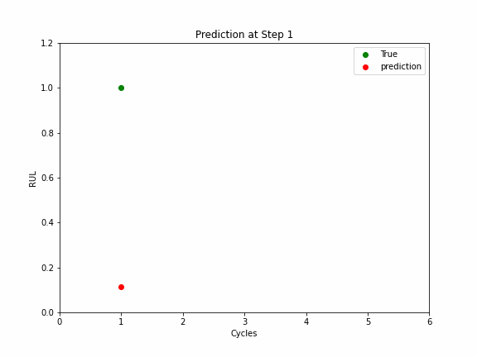
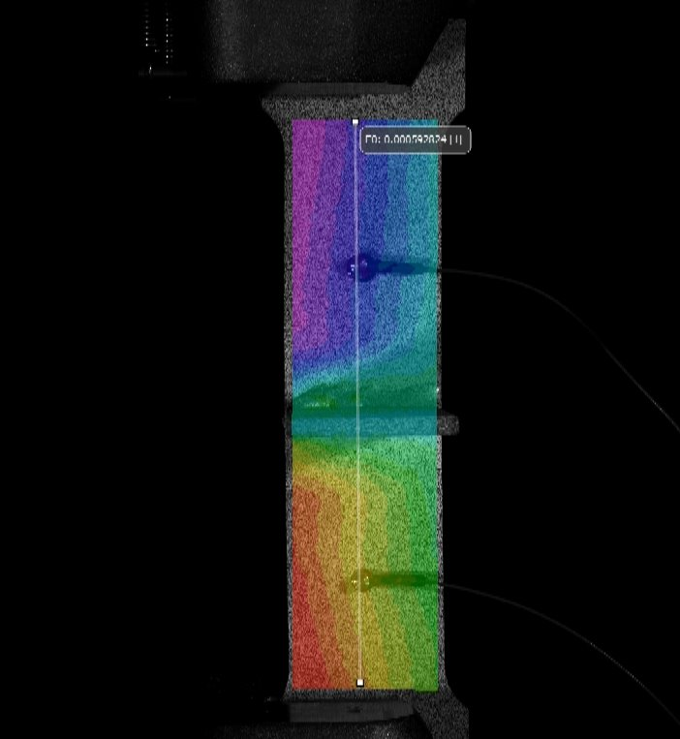
2. Forecasting
In this study, we used acoustic emission (AE) signals to track the frequency of hits per cycle during a fatigue test. This data was used to train a LSTM model to predict failure. By analyzing the AE hit frequency as the material neared failure, the model demonstrated a strong correlation between AE signals and impending failure, offering a method for early detection in fatigue testing.
In addition to acoustic emission extracted features, we incorporated load and strain sensors to predict failure in monotonic tests. By combining these data sources, we trained a model to forecast the force at which failure occurs. The model focuses on detecting significant changes, such as a drop in force or crossing a predefined threshold, which are indicative of material failure.

Slide 14
Reference
Ciaburro, G.; Iannace, G. Machine-Learning-Based Methods for Acoustic Emission Testing: A Review. Appl. Sci. 2022, 12, 10476. https://doi.org/10.3390/app122010476
Whiting, Justin et al. “Real-time acoustic emission monitoring of powder mass flow rate for directed energy deposition.” Additive manufacturing vol. 23 (2018): 10.1016/j.addma.2018.08.015. doi:10.1016/j.addma.2018.08.015
Wirtz, Sebastian & Cunha, Adauto & Beganovic, Nejra & Söffker, Dirk. (2018). High-speed data acquisition system for continuous acoustic emission monitoring and real-time signal processing using FPGA-based platform within a SHM framework.

Slide 15
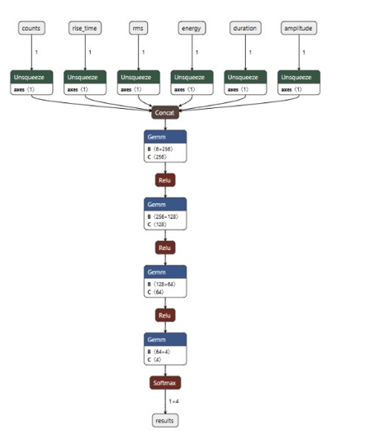
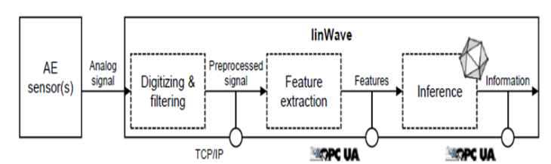
(a)
(d)
(b)
(c)

Slide 16
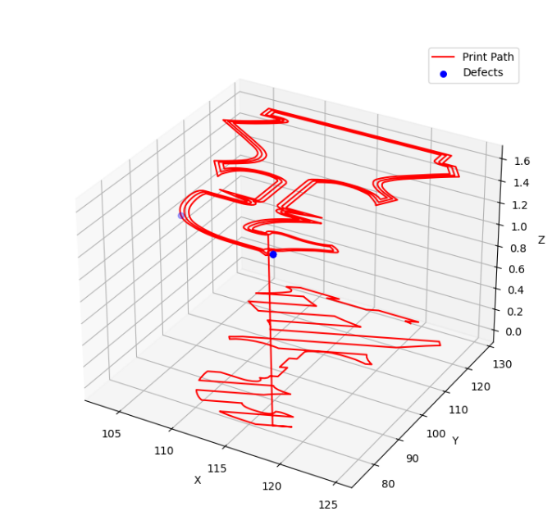
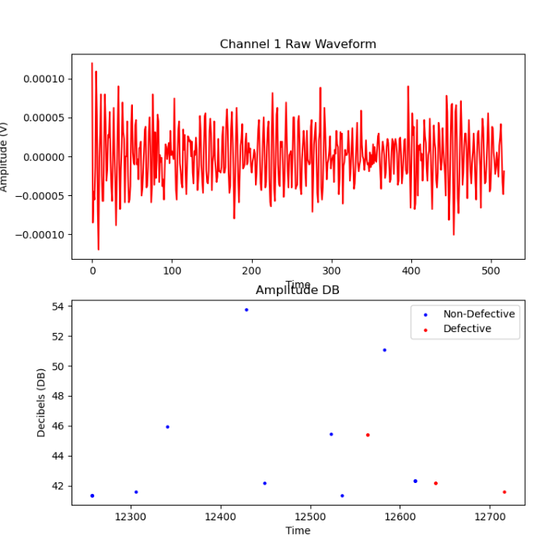
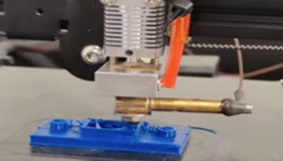
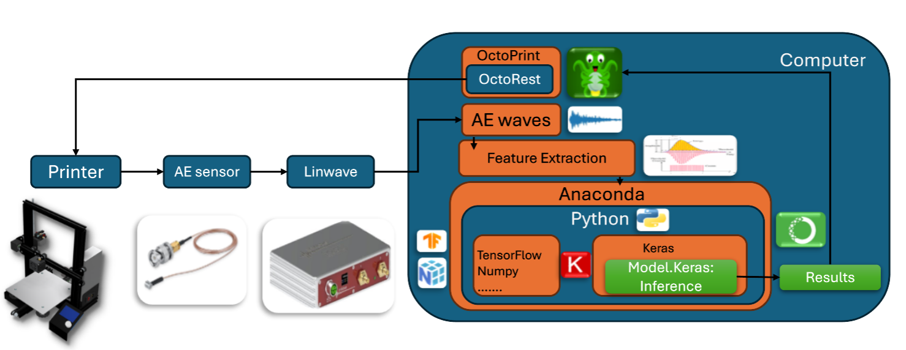
(a)
(b)
(c)
(d)

